Slide 1
Installation Guide
Dynamic Mathematics Principles
Team: Andres Cubas, Ingrid Troche
Mentor: Mario Eraso

Slide 2
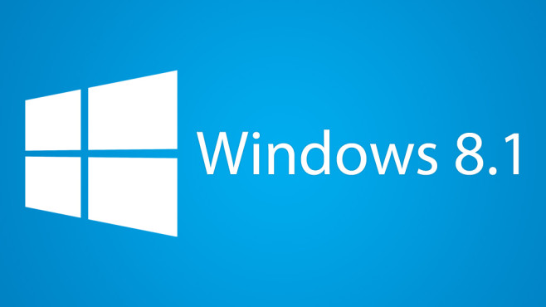





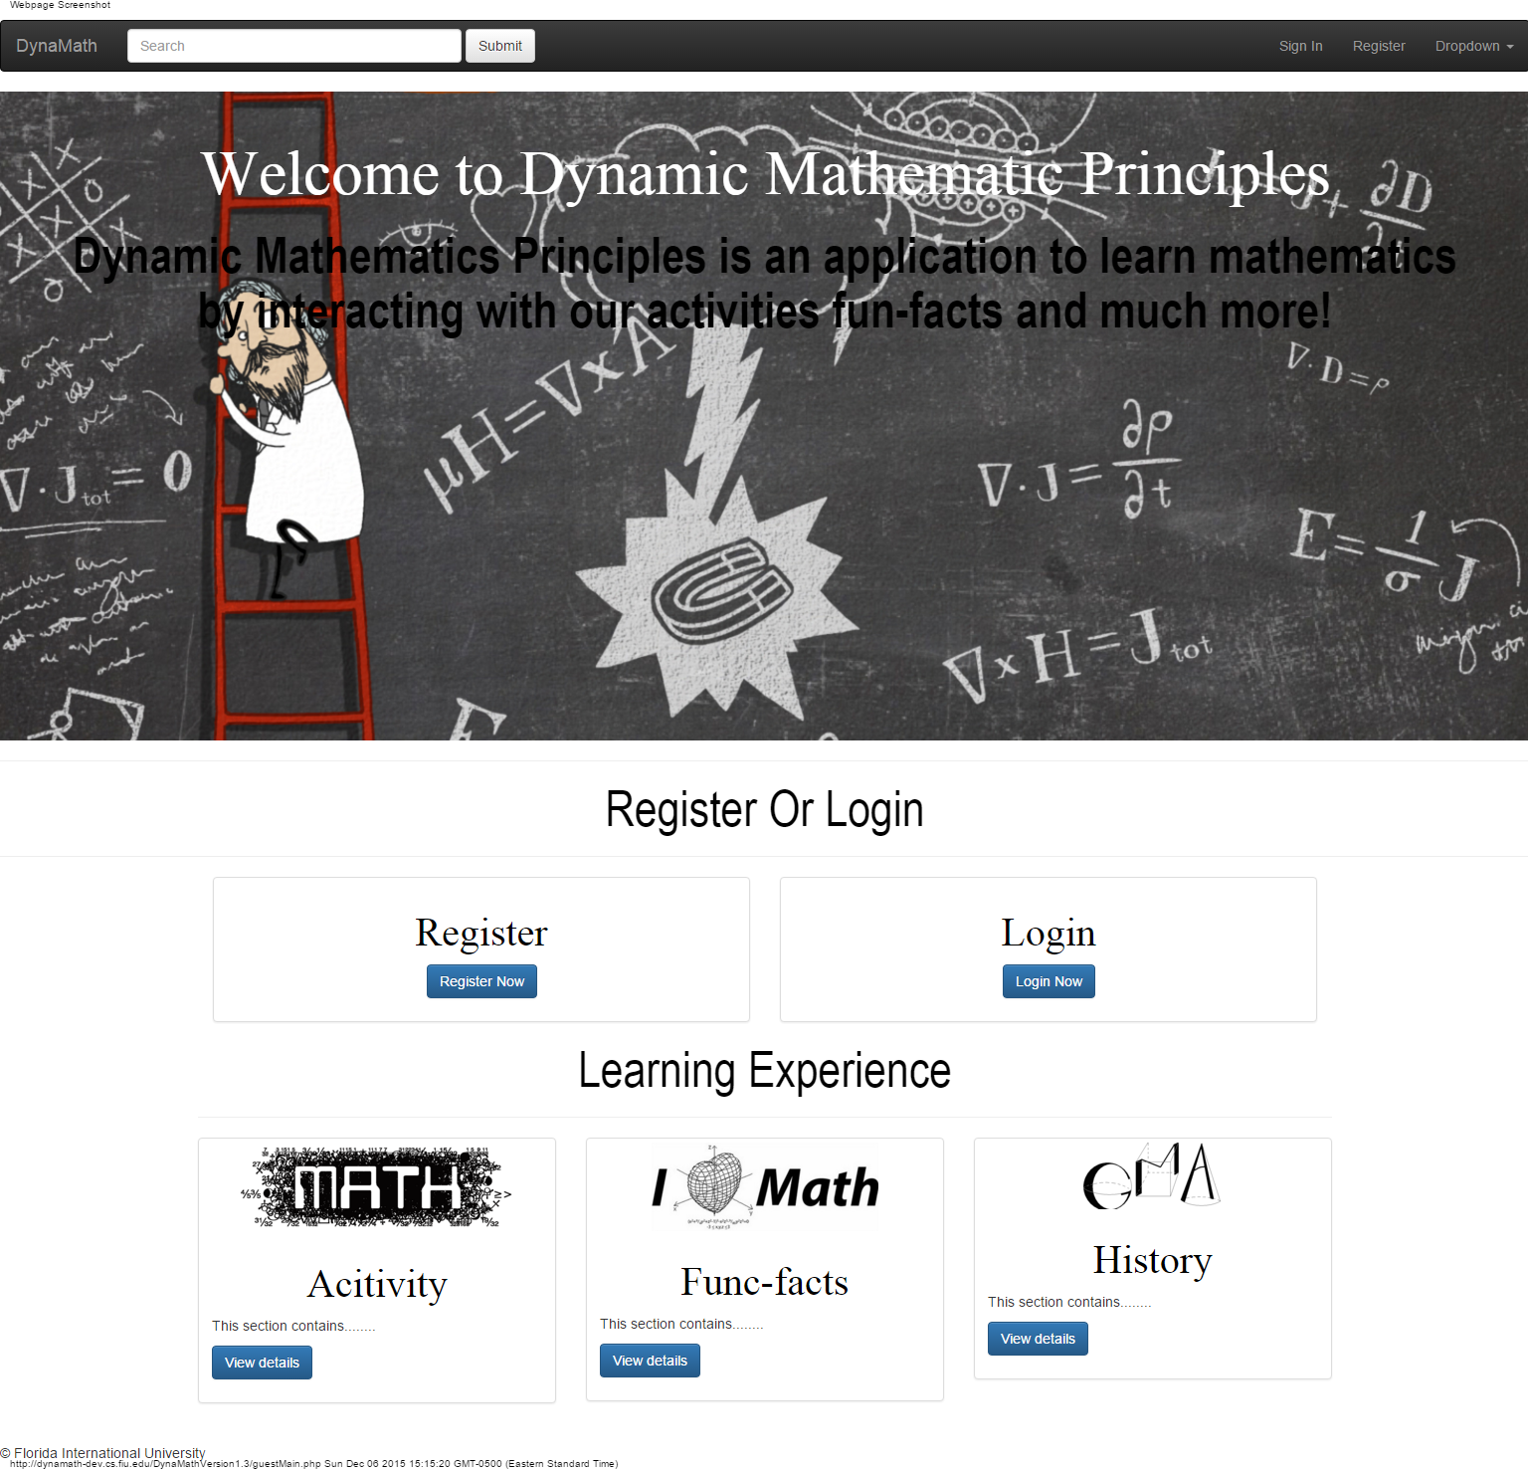
System Requisites
Operating Systems that may be used for the system:
Windows 8.1
Mac OS
Ubuntu 14.04 LTS
Required software:
MySQL
PHP5
Apache
SendMail

Slide 3



Useful Environments
Local:
XAMPP
MAMP
Server:
LAMP

Slide 4

Installing the Database
Create a new database labeled lr with utf8_general_ci as it’s collation attribute.

Slide 5


Installing the Database

Slide 6

Final Useful Points
The code was made to run on a server whise location is http://dynamath-dev.cs.fiu.edu/
In order to change, its location (such as on a local computer) the code might have to be changed appropriately in places where urls or “header” is used to work on the new address (i.e. localhost).

